Slide 1
Introduction to Cybersecurity
Chapter 3
Dr. Mohammed Tawfik

Slide 2
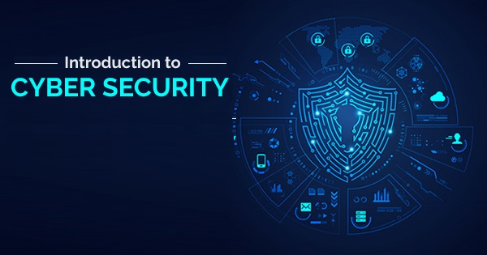
Chapter 3:
Physical and Computer Security
Dr. Mohammed Tawfik

Slide 3
Outline
Understanding Physical Security
Physical Security Breach Incidents
What Is the Need for Physical Security?
Who Is Accountable for Physical Security?
Factors Affecting Physical Security
Understanding Computer Security
Principles of Computer Security
Security Breach
Types of Threats/Security Attacks

Slide 4
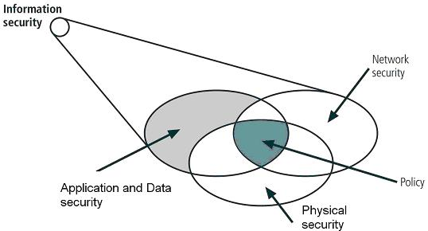
Physical Security
What means physical security?
Physical security refers to the protection of building sites and equipment (and all information and software contained therein) from theft, vandalism, natural disaster, manmade catastrophes, and accidental damage (e.g., from electrical surges, extreme temperatures, and spilled coffee).

Slide 5
Physical Security
Generally security measures can be categorized in the following three ways:
1. Physical :
Physical measures to prevent access to systems include security guards, lighting, fences, locks, and alarms. Facility access points should be limited, and they should be monitored/protected by closed-circuit television (CCTV) cameras and alarms. The entrance to the facility should be restricted to authorized people.

Slide 6
Physical Security
Access : to laptop systems and removable media such as removable drives, backup tapes, and disks should be restricted and protected. Computer screens should be positioned such that they can’t be seen by passers-by, and a policy should be implemented and enforced that requires users to lock their systems when they leave the computer for any reason.
Computer systems with highly sensitive data should be protected in an enclosed and locked area such as a credential-access room with a rack-mount case and lock.

Slide 7
Physical Security
2. Technical
Technical security measures such as firewalls, IDS, spyware content filtering, and virus and Trojan scanning should be implemented on all remote client systems, networks, and servers.
3. Operational
Operational security measures to analyze threats and perform risk assessments should be a documented process in the organization’s security policy.

Slide 8
Physical Security Breach Incidents
Equipment theft is one of the most common physical security attacks. Most people don’t expect their computer to be stolen and are native about locking down host systems; instead, they rely on standard network security mechanisms. Many insider attacks are the result of physical security breaches. Once a hacker has gained physical access to the server, a single client system, or a network port, the results can be disastrous.

Slide 9
Physical Security Breach Incidents
In addition, such breaches are difficult to identify, track or locate. Some of the common security breaches caused by insufficient physical security are as follows:
Installation of malware such as keyloggers, viruses, Trojans, backdoors, or rootkits
Identification and capture of validation or authentication credentials such as passwords or certificates

Slide 10
Physical Security Breach Incidents
Physical connection to the wired network to sniff confidential data such as passwords and credit card numbers.
Access to systems to collect data that can be used to crack passwords stored locally on the system.
Opportunity to plant rogue access points to create an open wireless network with access to the wired network

Slide 11
Physical Security Breach Incidents
Theft of paper or electronic documents
Theft of sensitive fax information
Dumpster diving attack (emphasizing the need to shred important documents)

Slide 12
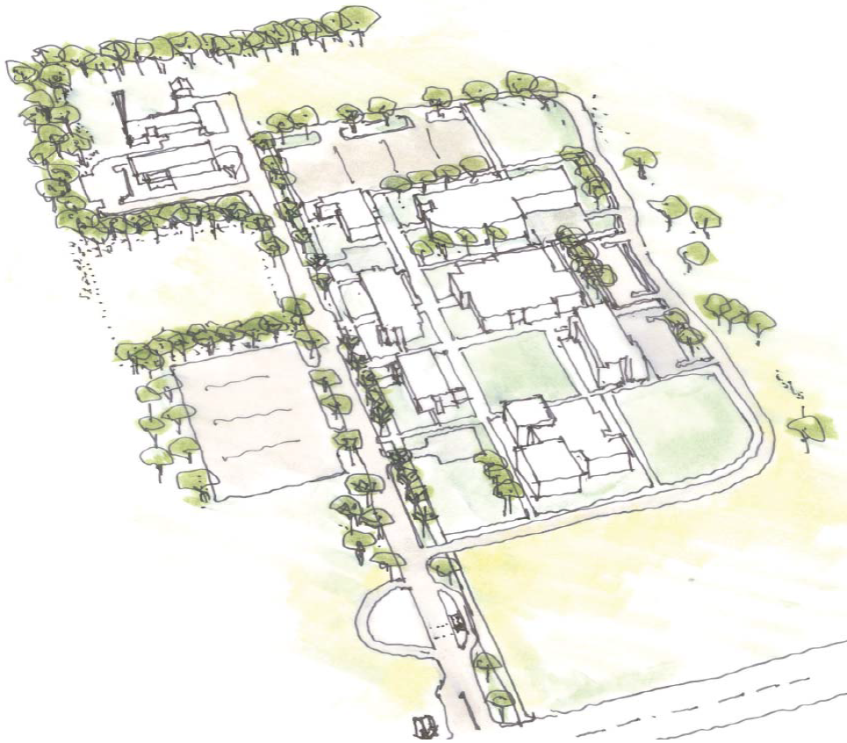
Design

Slide 13
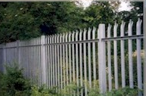
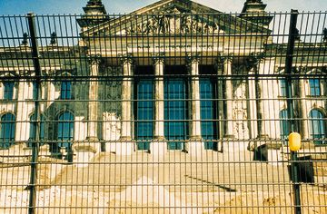
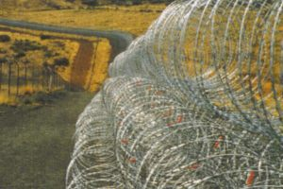
Fences

Slide 14


Security Guards

Slide 15
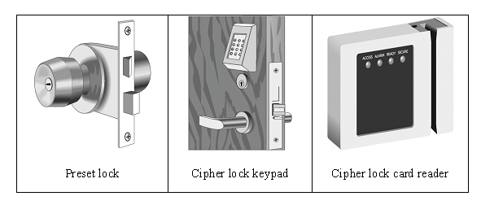
Locks

Slide 16
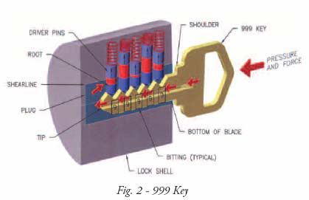
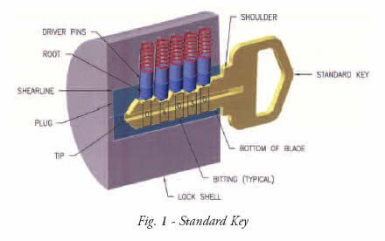
Locks

Slide 17
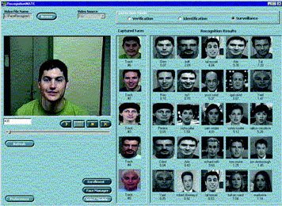



Biometric Options

Slide 18
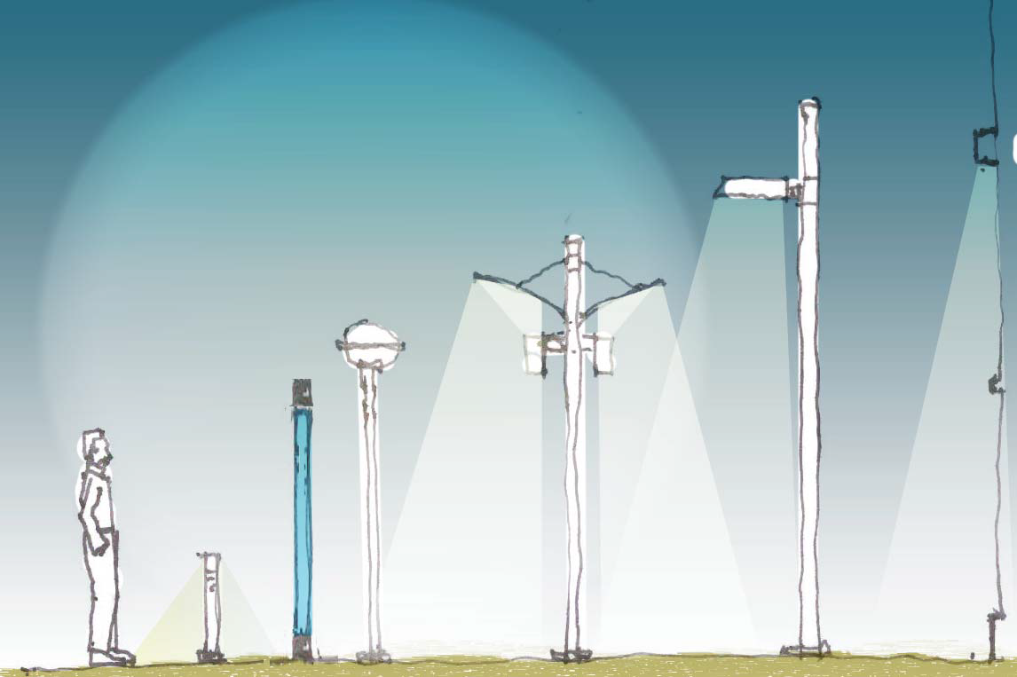
Lighting

Slide 19
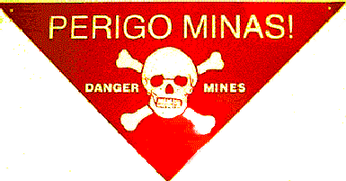

Warning Signs

Slide 20



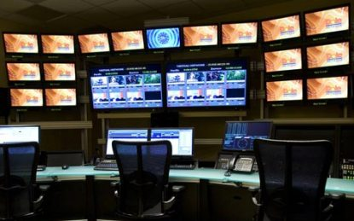
Monitoring

Slide 21
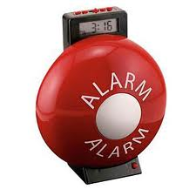
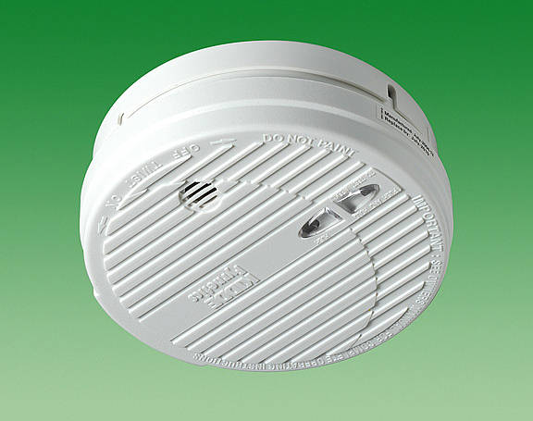
Alarms

Slide 22
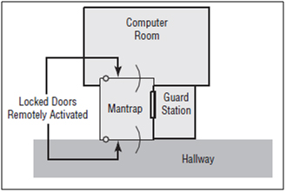
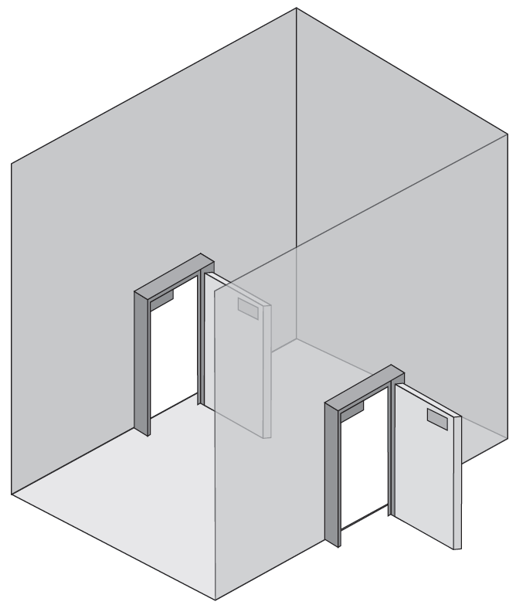
Mantrap

Slide 23
What Is the Need for Physical Security?
You need physical security measures for the same reason you need other types of security (such as technical or operational) to prevent hackers from gaining access to your network and your information. A hacker can easily get such access through weaknesses in physical security measures. In addition, data can be lost or damaged by natural causes; so, risk managers must add natural disasters to the equation when planning appropriate security.

Slide 24
What Is the Need for Physical Security?
Physical security measures are designed to prevent the following:
Unauthorized access to a computer system
Stealing of data from systems
Corruption of data stored on a system
Loss of data or damage to systems caused by natural causes

Slide 25
Who Is Accountable for Physical Security?
The following people in an organization should be accountable for physical security:
The organization’s physical security officer
Information system professionals
Chief information officer
Employees
Everyone in an organization is responsible for enforcing physical security policies.

Slide 26
Factors Affecting Physical Security
Physical security is affected by factors outside the physical security controls. Factors that can affect an organization’s physical security include the following:
Vandalism
Theft
Natural causes, such as
Earthquake
Fire
Flood

Slide 27
Factors Affecting Physical Security
Security professionals need to be aware of these risk factors and plan accordingly. Many organizations create a business continuity plan (BCP) or disaster recovery plan (DRP) to prepare for these possibilities.

Slide 28
Recommendations
Recommended key management procedures
Restricting access to equipment areas
Change locks after key loss or theft
Inspect locks regularly
Issue keys only to authorized users
Keep records of who uses and turns in keys
Keep track of issued keys
Set up key monitoring procedure
Combination sequence necessary to open door

Slide 29
Recommendations (cont.)
Access list
Prevent unauthorized users from gaining physical access to equipment
Record of individuals who have permission to enter secure area
Records time they entered and left
Mantrap
Separates a secured from a non secured area
Device monitors and controls two interlocking doors
Only one door may open at any time

Slide 30
Computer Security

Slide 31
Computer Security
Definition:
Computer Security is the ability of a system to protect information and system resources with respect to confidentiality and integrity.
Aspects of Security:
Prevention: take measures that prevent your assets from being damaged
Detection: take measures so that you can detect when, how, and by whom an asset has been damaged
Reaction: take measures so that you can recover your assets or to recover from a damage to your assets

Slide 32
Principles of Computer Security
Application
Software
User
(subject)
Resource
(object)
Hardware
Where to focus security controls?
Data: Format and content of data
Operations: Operations allowed on data
Users: Access control of data based on user

Slide 33
Computer Security
Is defined as the protection afforded to an automated information system in order to attain the applicable objectives of preserving the integrity, availability and confidentiality of information system resources (includes hardware, software, firmware, information/data, and telecommunications).

Slide 34
Security Goals
Confidentiality
Integrity
Avalaibility

Slide 35
Authenticity and Accountability
Two additional objectives:
Authenticity- being genuine and able to be verified or trust; verifying that users are who they say they are
Accountability- actions of an entity can be traced uniquely to that entity; supports nonrepudiation, deterrence, fault isolation, intrusion, detection and prevention.

Slide 36
Security Breach
Levels of Impact
We can define 3 levels of impact from a security breach:
Low
Moderate
High

Slide 37
Examples of Security Requirements
Confidentiality – students system
High confidentiality - grades
Only available to students, parents and employees (who need it to do their job)
Moderate confidentiality –enrollment
Low confidentiality – Directory information
Lists of departments, faculty, students
Available to the public
Often published on Web site

Slide 38
Examples of Security Requirements
Integrity- patient information
High requirement for integrity
–Medical database, if falsified or inaccurate, could cause harm ( allergies, etc.)
Medium requirement for integrity
Web site that offers a forum for discussion of medical topics, not for research
Low requirement for integrity
Anonymous poll (such as a patient satisfaction)

Slide 39
Examples of Security Requirements
Availability - The more critical a component or service is, the higher the level of availability required:
High availability- authentication service
Interruption of service results in being unable to access computing resources
Moderate availability- College web site
Provides information but is not critical
Low availability- online phone directory
Other sources of information are available

Slide 40
Types of Security Threats/Attacks

Slide 41
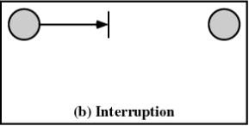
Types of Threats/Security Attacks
Interruption
An asset of the system is destroyed and becomes unavailable or unusable
Attack on availability
Destruction of hardware
Cutting of a communication line
Disabling the file management system

Slide 42
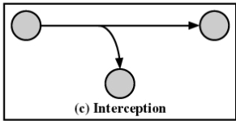
Types of Threats
Interception
An unauthorized party gains access to an asset
Attack on confidentiality
Wiretapping to capture data in a network
Illicit copying of files or programs

Slide 43
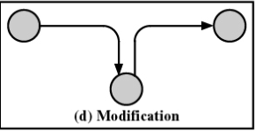
Types of Threats
Modification
An unauthorized party not only gains access but tampers with an asset
Attack on integrity
Changing values in a data file
Altering a program so that it performs differently
Modifying the content
of messages being transmitted
in a network

Slide 44
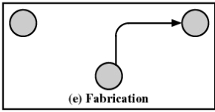
Types of Threats
Fabrication
An unauthorized party inserts counterfeit objects into the system
Attack on authenticity
Insertion of spurious messages in a network
Addition of records to a file

Slide 45
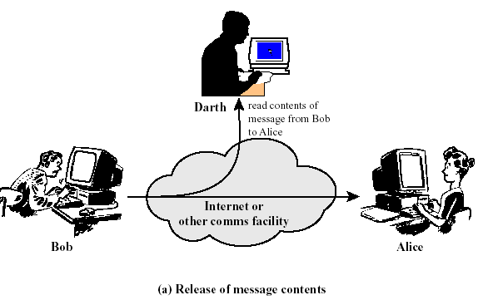
Two types of Attacks
1- Passive Attacks

Slide 46
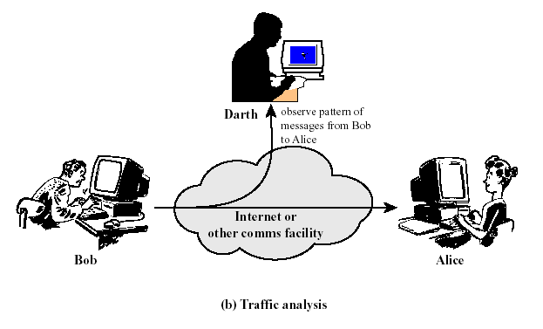
1)Passive Attacks

Slide 47
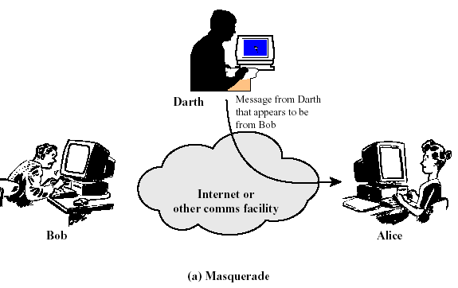
2) Active Attacks

Slide 48
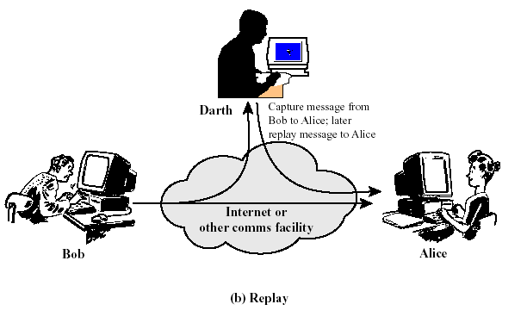
3)Active Attacks

Slide 49
Summary of Passive and Active Threats

Slide 50
Thank you

